Slide 1
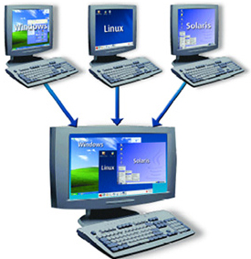
LINUX – THE LINUX FILE SYSTEM PART 1
Docente: Dott. Daniele Gobbo Modulo 3

Slide 2
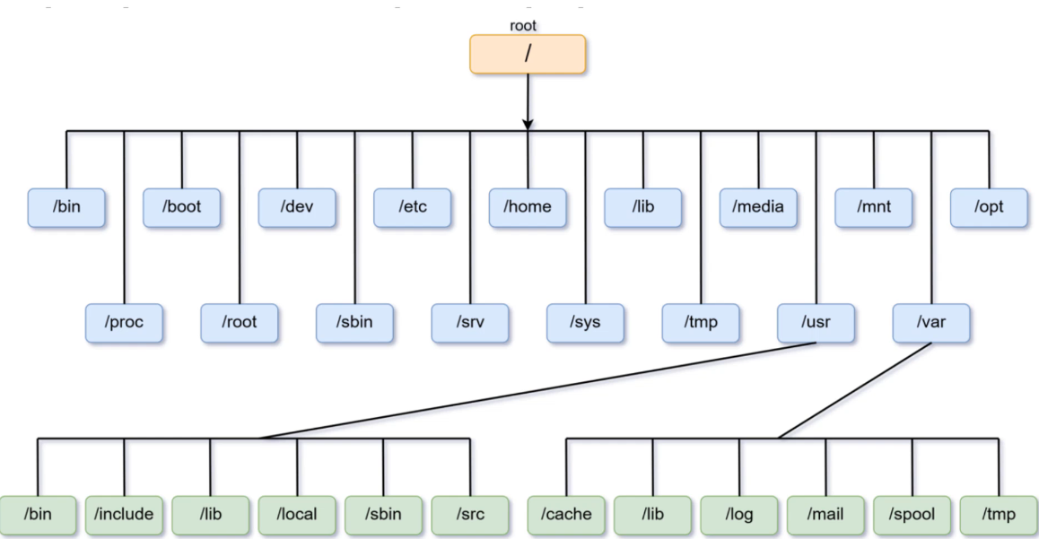
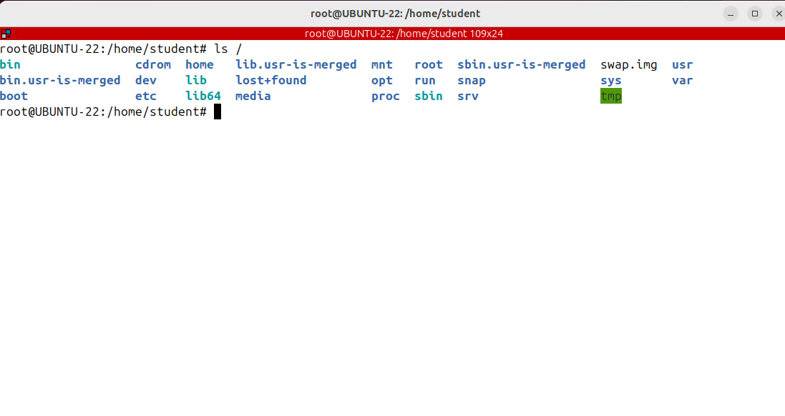
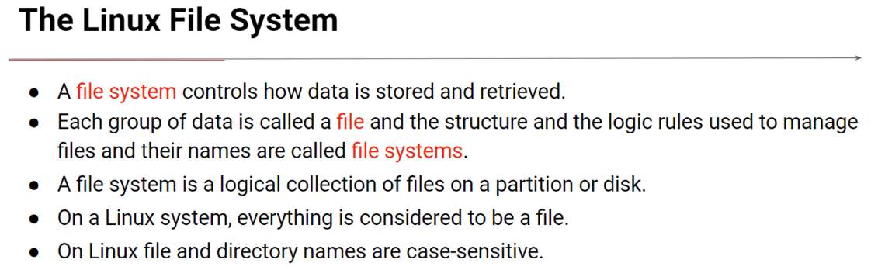
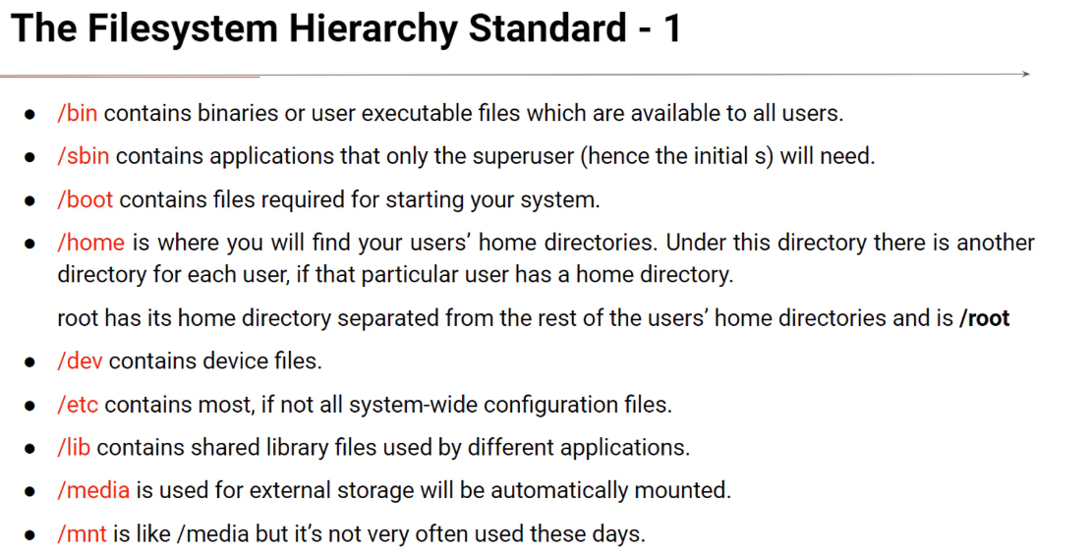
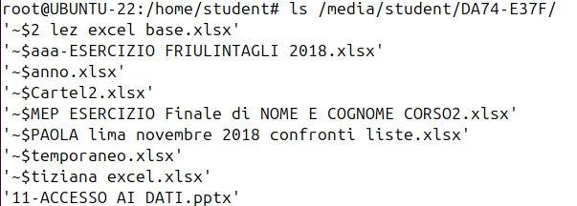
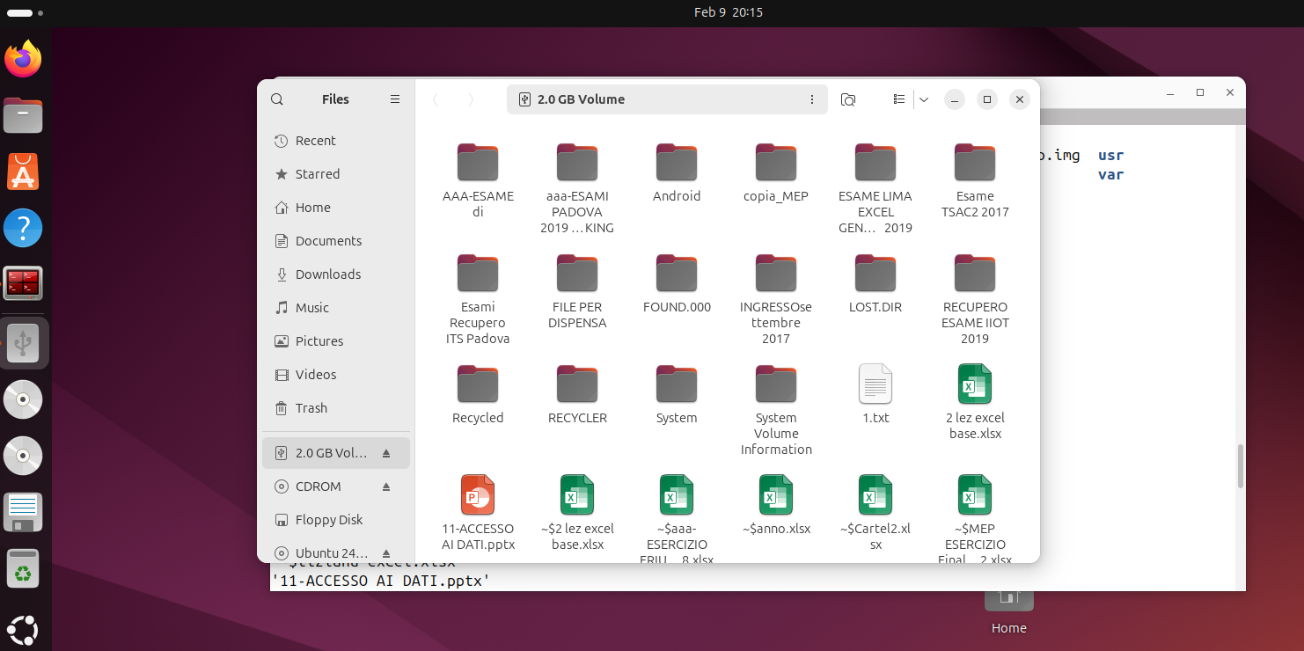
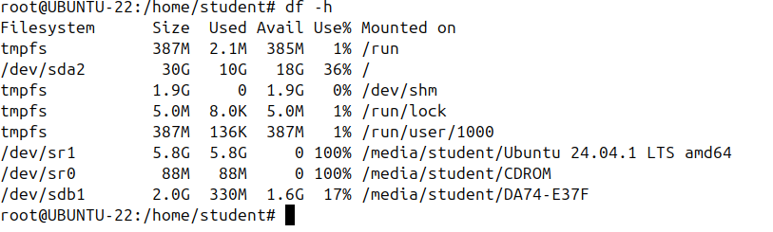
INTRO TO THE LINUX FILESYSTEM
In the file system hierarchy standard all files and directories appear under the root directory, even if they are stored on different physical devices like on different disks or partitions.
This is one of the differences when comparing to Windows file system where there isn't such a unique file system tree.
Imagine that on Windows you can have more partitions or disks which are accessed as drive letters in my computer without a common directory at the base.
In Linux there is only one file system tree under the root directory at the very top.
When you want to access an additional file system, like the one on a USB stick, you need to mount it or logically attach it to an existing directory of the unique file system. That directory is called Mount Point.
Just to make it clear, I’ll insert a USB stick.

Slide 3
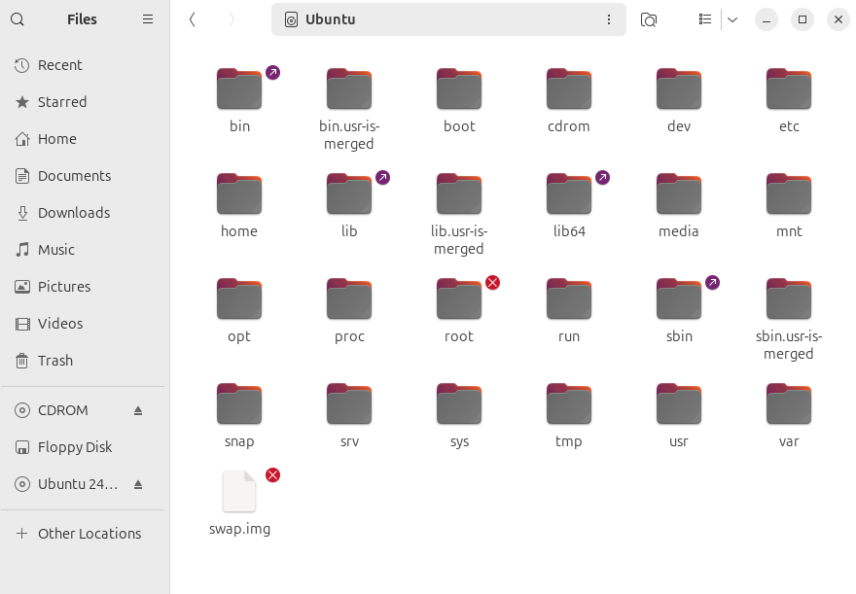
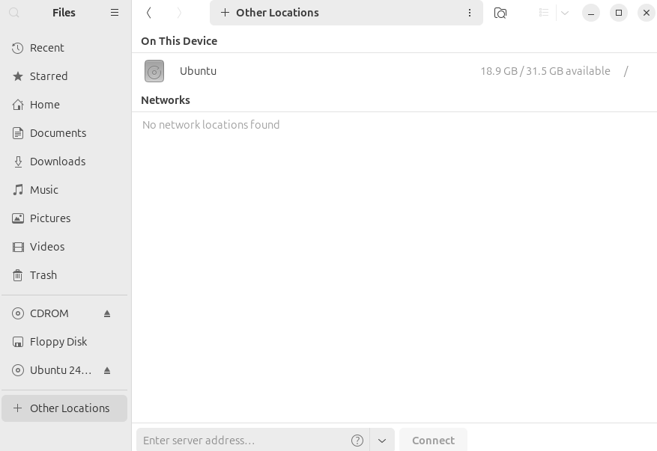
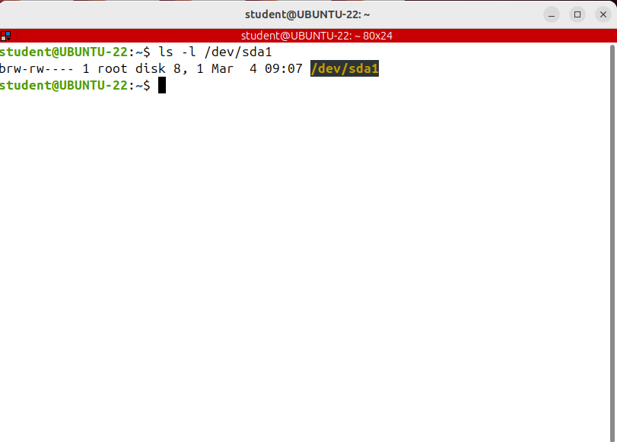
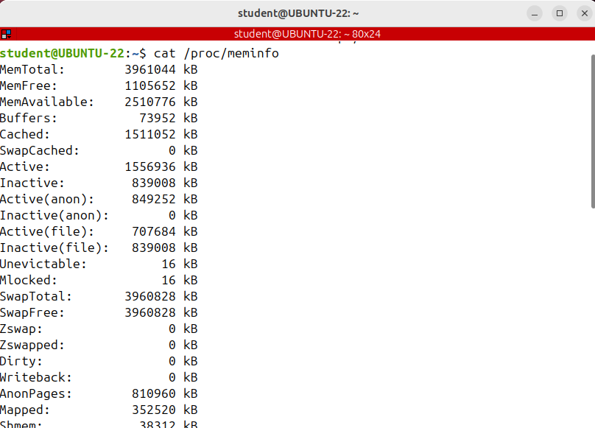
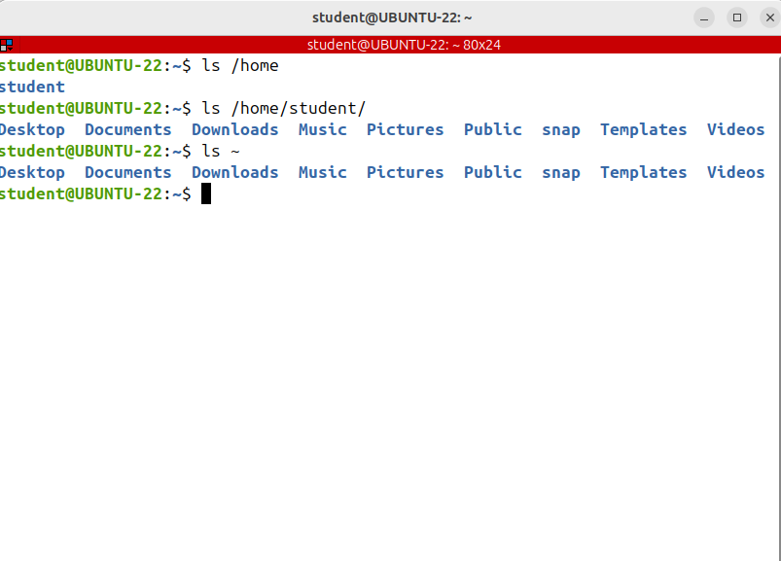
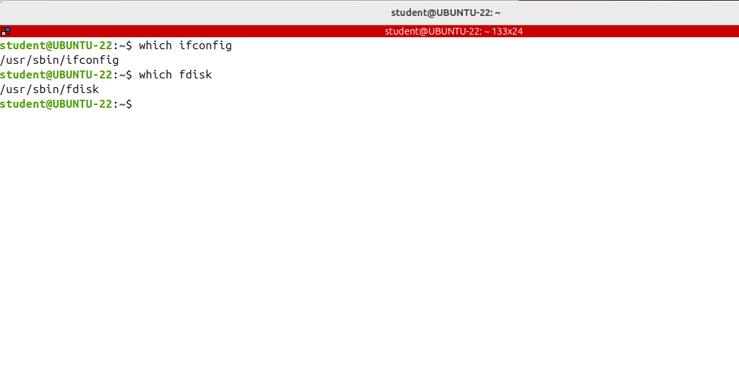
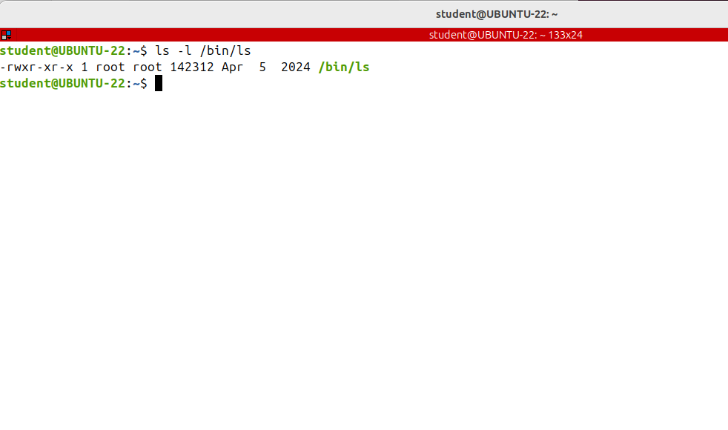
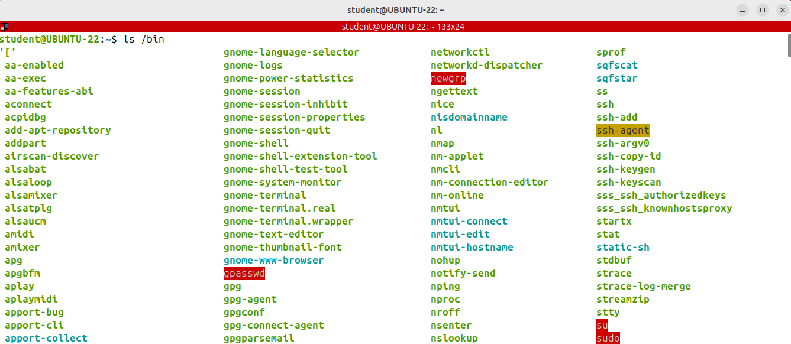
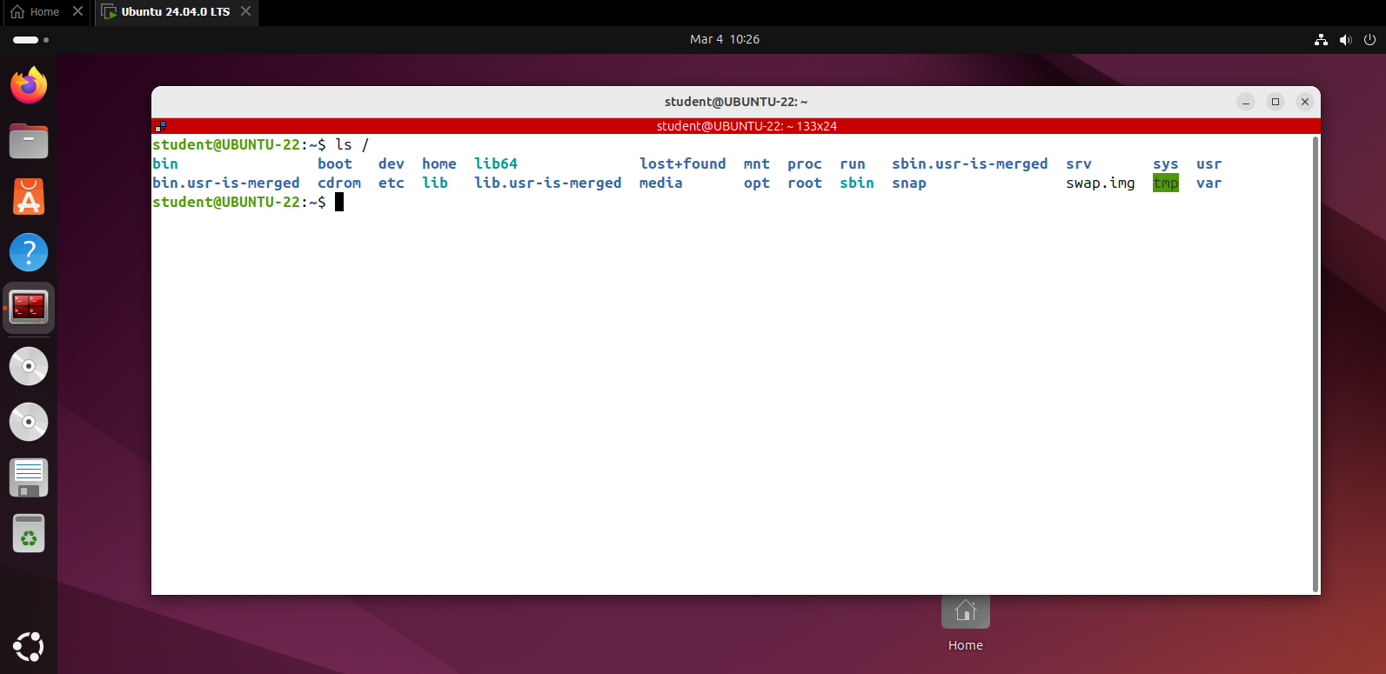
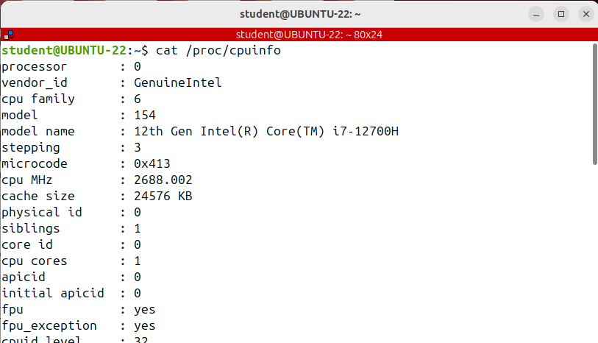
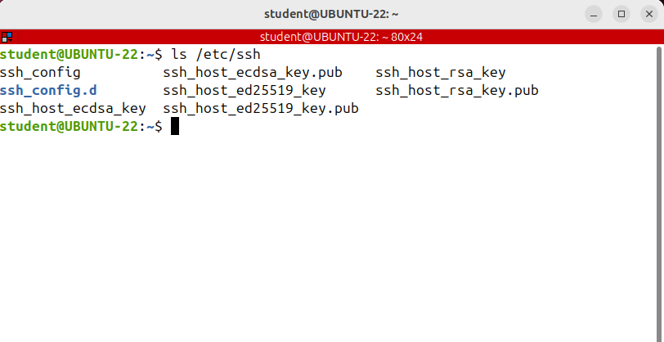
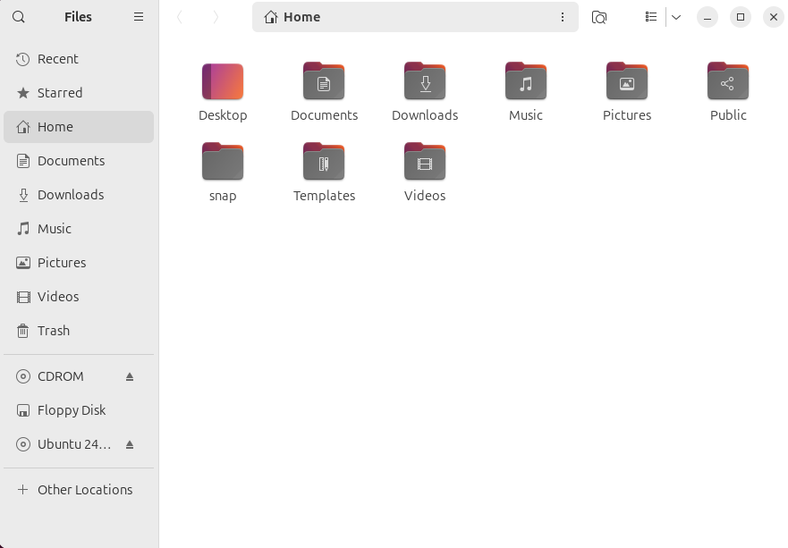
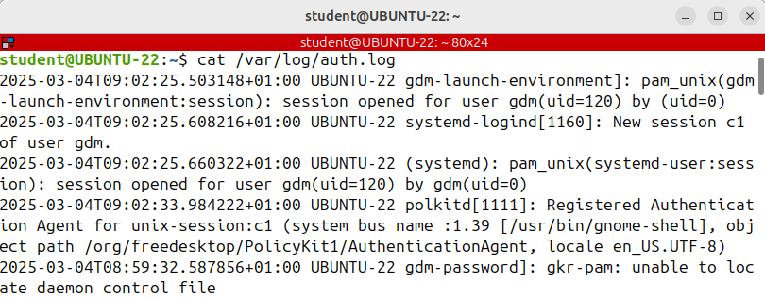
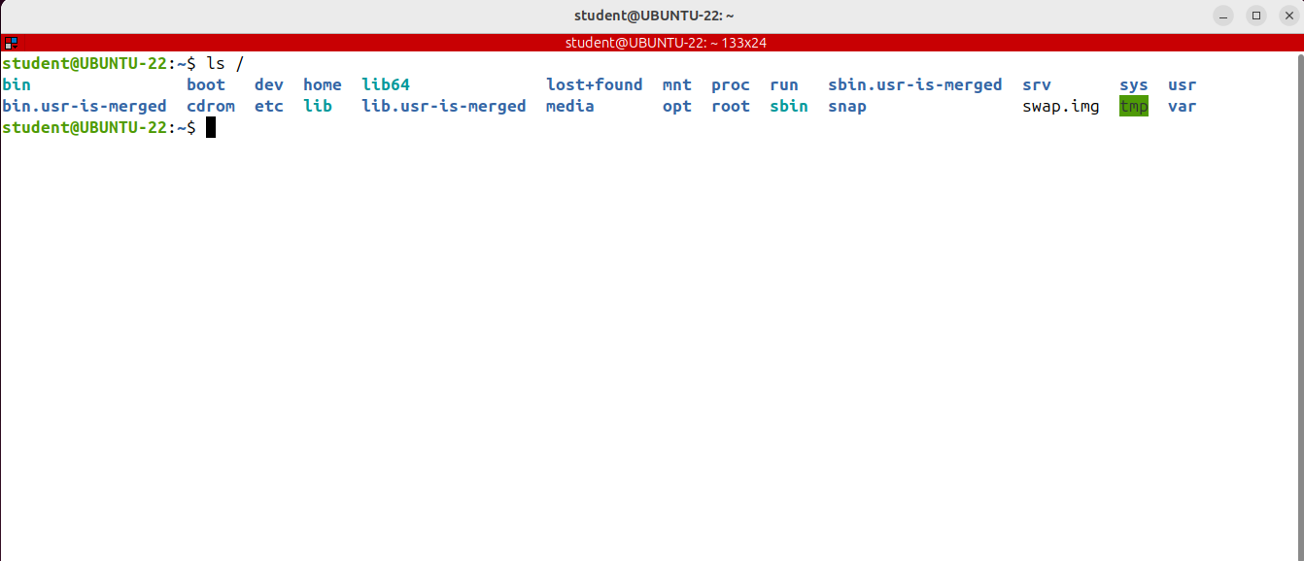
THE FILE SYSTEM HIERARCHY STANDARD (FHS)
Dev contains device files; many of these are generated at boot time or even on the fly.
This directory contains the device files for every hardware device attached to the system, like a hard disk or a partition.
These are not device drivers, rather they are files that represent each device on the computer and facilitate the access to those devices.
Remember that in Linux everything is a file and the disk partition is logically represented as a special file as well.
The Linux directory structure is well defined and documented in the Linux Filesystem Hierarchy
Standard (FHS) which is maintained by Linux foundation.
/usr was the initial user’s home directory in the early days of Unix.
However these days /home took its place and /usr contains many other subdirectories withbinary files, shared libraries and so on.
On some distributions like CentOS many commands are saved in /usr/bin or in /usr/sbin instead of /bin and /sbin
/run directory is fairly new and different distributions use it in different ways.
It’s a temporary filesystem which runs in RAM so its contents will vanish when the system reboots.
This directory is used only by processes.
There’s another directory called /sbin which is similar to /bin, but it contains applications that only the superuser (hence the initial s) will need.
These executables are used for system administration.
ifconfig used to configure the network adapter or fdisk used to manipulate disk
partitions.
/var. It contains variable-length files such as logs which are files that register events
that happen on the system.
/proc is a virtual directory.
It contains information about your computer hardware, such as information about your CPU, RAM memory
or Kernel. The files and directories are generated when your computer starts or on the fly as your system is running and things change.
The media directory is where the external storage will be automatically mounted when you plug it and
try to access it. When you insert an external hard disk or USB stick they will be automatically mounted and made available for you under / media.
/mnt is like /media but it’s not very often used these days. It was the mount point for the cdroms or the floppy disks.
The /srv directory is designed to contain data provided by services offered by the system.
This means that if your server hosts a website, an FTP server, or any other service, the files and directories associated with those services should be stored in /srv.
lib contains shared library files used by different applications.
You don't talk to this directly. The package manager can update it accordingly when you install, remove or update an application.
/tmp contains temporary files, usually saved there by applications that are running. Non-privileged users may also store files there temporarily. Note that files stored in this directory may be deleted at any time without prior notice.
/home is where you will find your users’ home directories. Under this directory
there is another directory for each user, if that particular user has a home directory.
In this example, the user called student has as home directory
the directory called student under /home..
Another interesting and well-known directory is ETC, it gets its name from the earliest Unix operating systems and it was literally etc. because it was the dumping ground for system files,
the system administrators were not sure where to put.
On a modern Linux distribution, it contains most, if not all system wide configuration files.
For example, the files that contain the users and their passwords, the groups, how the network is configured, or how a network service like a web or an e-mail server is configured are all of there.
The /bin directory contains binaries or user executable files which are available to all users.
For example the ls command we’ve just run is in this directory, along with other basic tools for copying and removing files and directories, moving them around and so on.
The boot directory contains files required for starting the system. You normally do not touch it.
Let's get started and look at what each directory is used for.

Slide 4
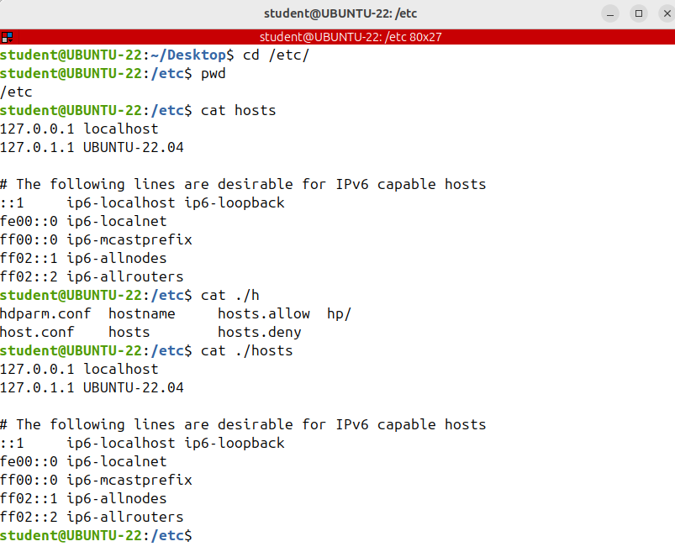
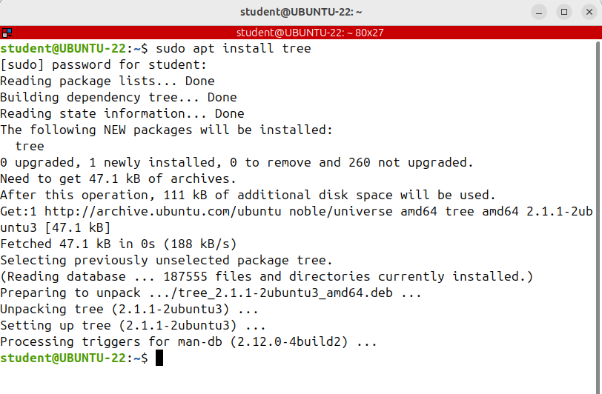
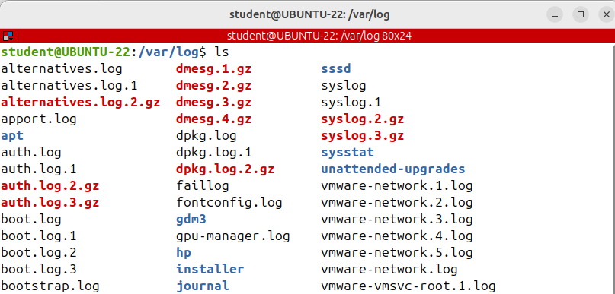
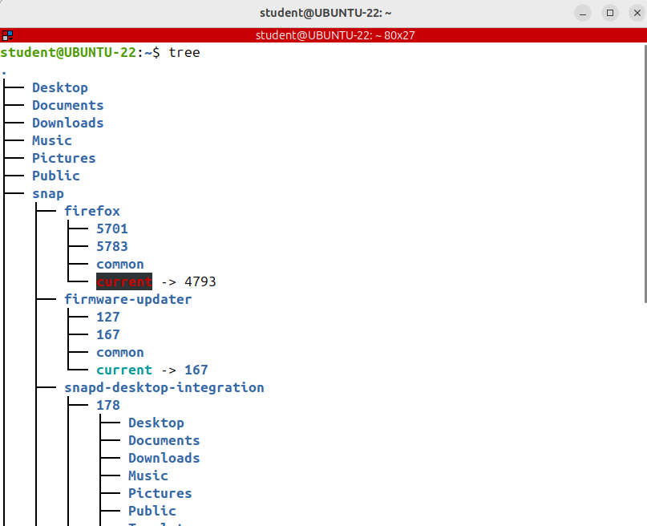
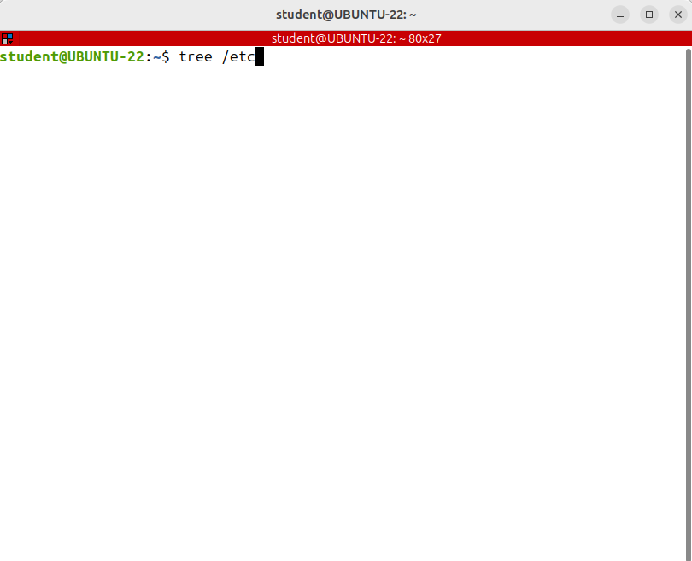
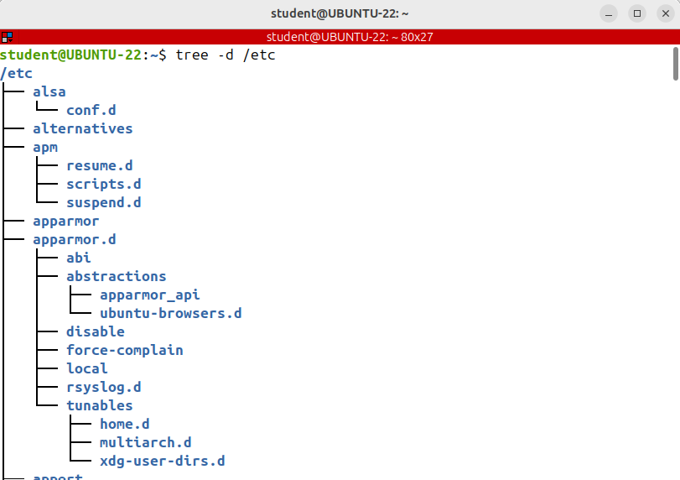
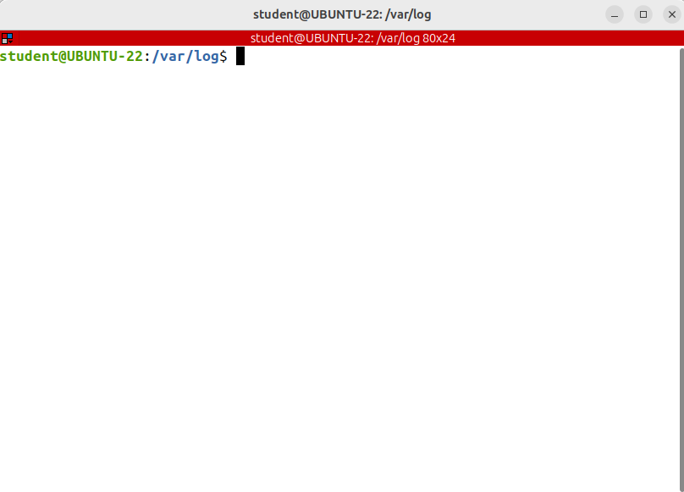
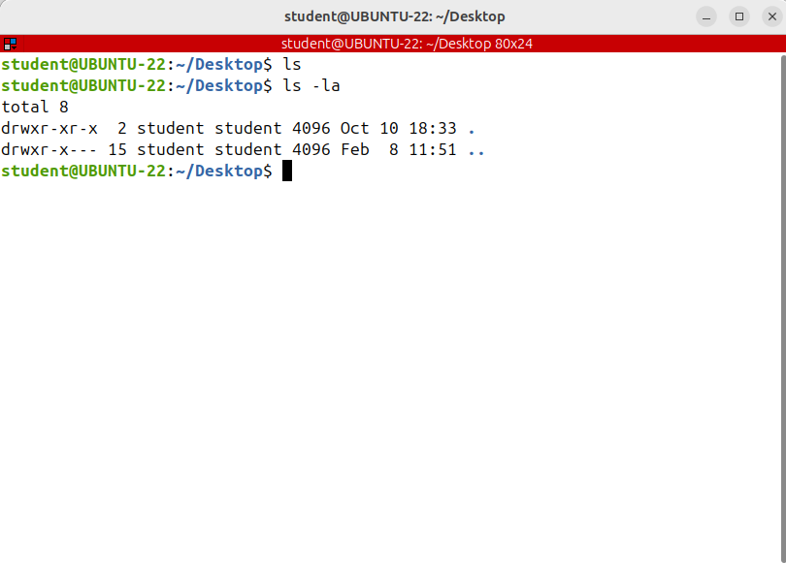
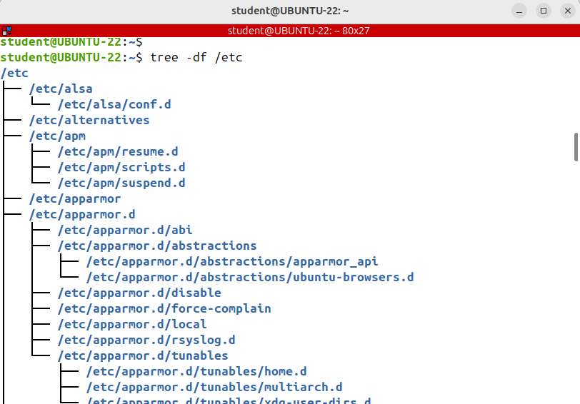
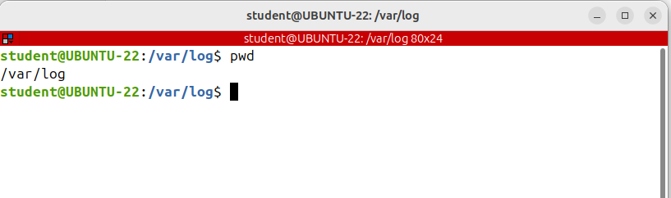
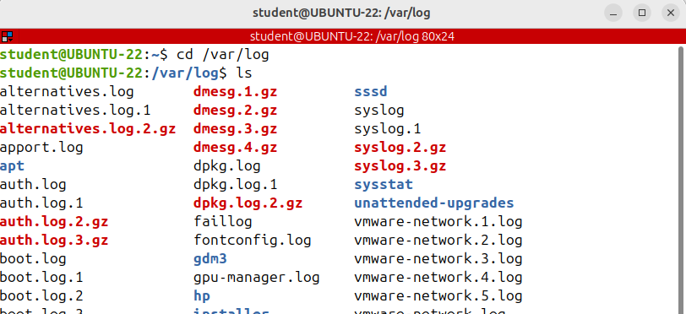
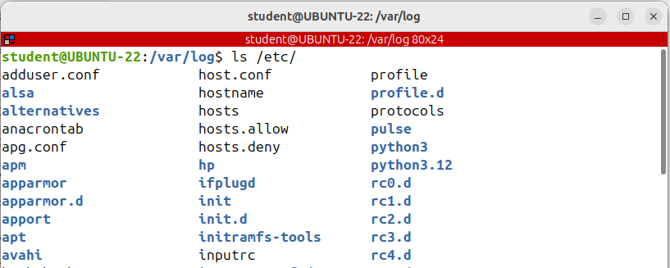
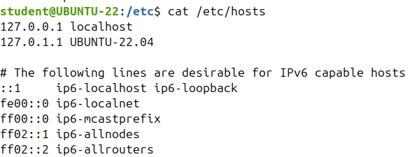
Absolute vs. Relative Paths. Walking through the File System (pwd, cd, tree)
The basic way to explore the Linux file system is to use the cd, pwd and ls commands.
cd stands for change directory and will take you to the directory you specify as argument.
To become proficient in working with the Linux file system is extremely important for any effective system administrator, you need to deeply understand what is a path and how to use it.
This is one of the most important concepts a beginner should learn.
Unfortunately, many times it brings a lot of confusion.
Absolute
Another nice command you can use to get used to paths is tree.
Tree is a recursive directory listing tool
that helps you see easier and clearer the parent and children directories .
Unfortunately, tree is not installed by default on Ubuntu.
Let's install it quickly.
sudo apt install tree
Relative
Before going on with the relative path, let's understand the special meanings of single dot and the double dot used in a relative path.
Put, a single dot (.) represents the directory you are in
Put two successive dots or double dot (..) represents the parent directory. On a Linux system
These items are automatically created in every directory
Using a single or double dot, we can build the relative path to any file or directory from the current working directory.
Let's try some examples:
An absolute path is defined by specifying the location of a file or directly from the root directory, which is /.
It's a complete path and always starts with /
It's listing all the files and directories that reside in /etc
It's listing all directories that reside in /etc
It's listing all directories that reside in /etc with Absolute path
what is a path?
Relative
A relative path is defined as the path related to the current working directly.
It begins at your current directory and never starts with a forward slash.
A path is a unique location to a file or a directory in the file system of an operating system. In Linux there are two types of path names: absolute and relative path names.
Absolute

Slide 5
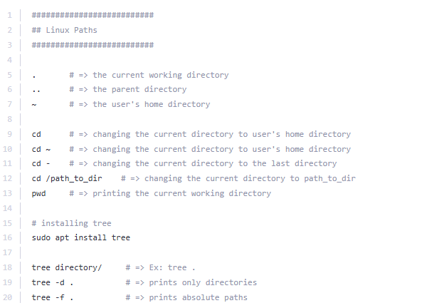
COMMANDS -PATHS

Slide 6
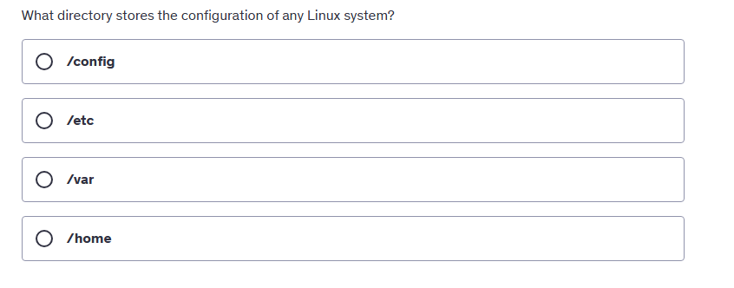
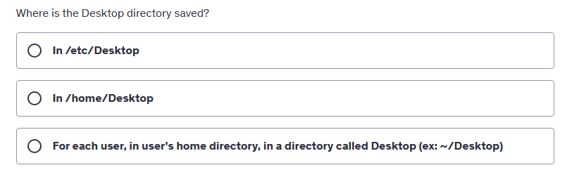
QUIZ

Slide 7
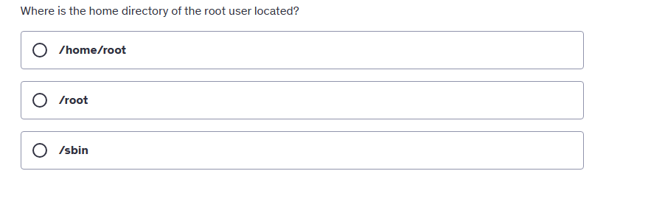
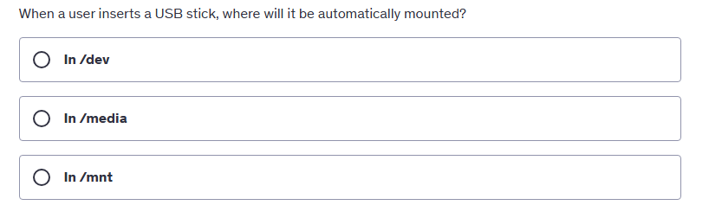
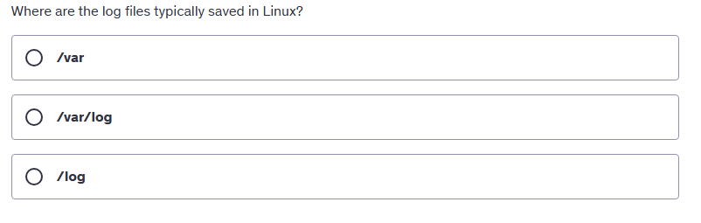
QUIZ

Slide 8
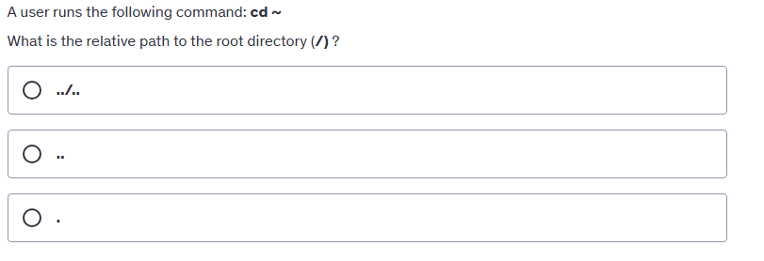
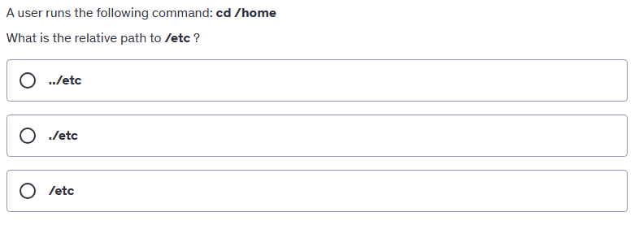
QUIZ

Slide 9
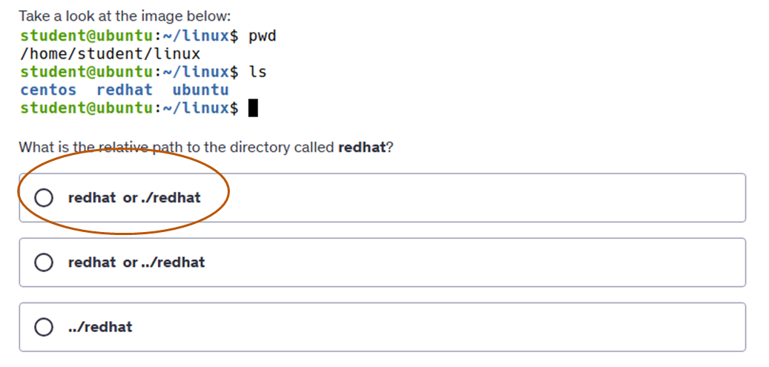
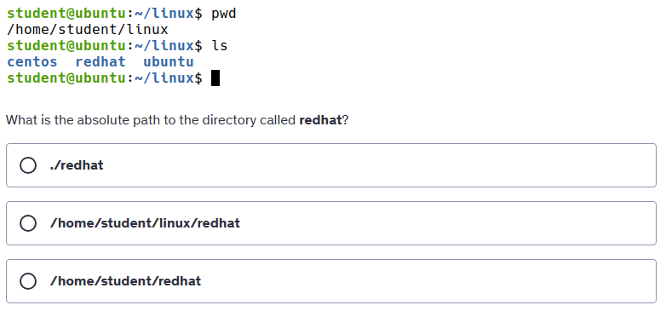
QUIZ

Slide 10
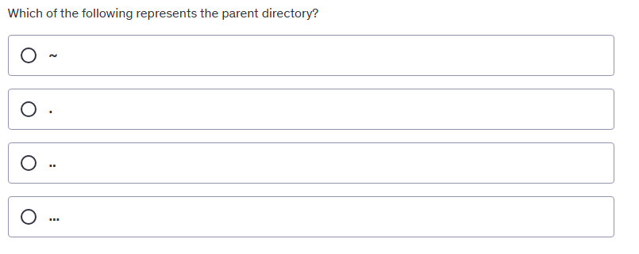
QUIZ

Slide 11
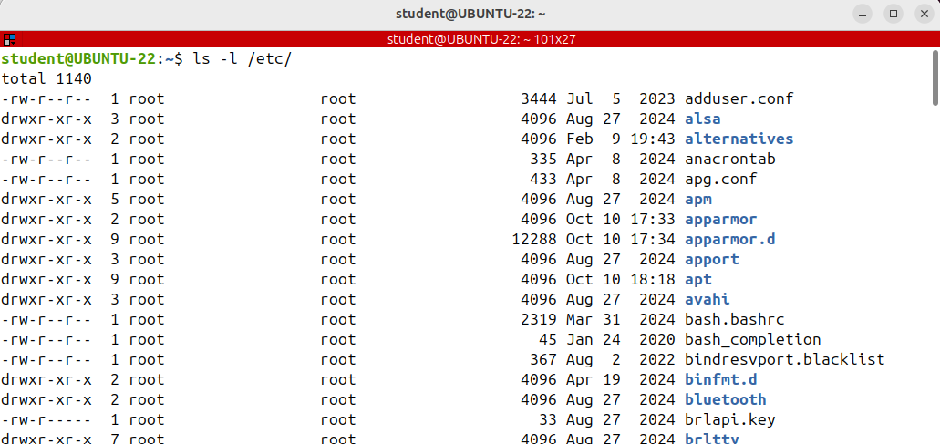
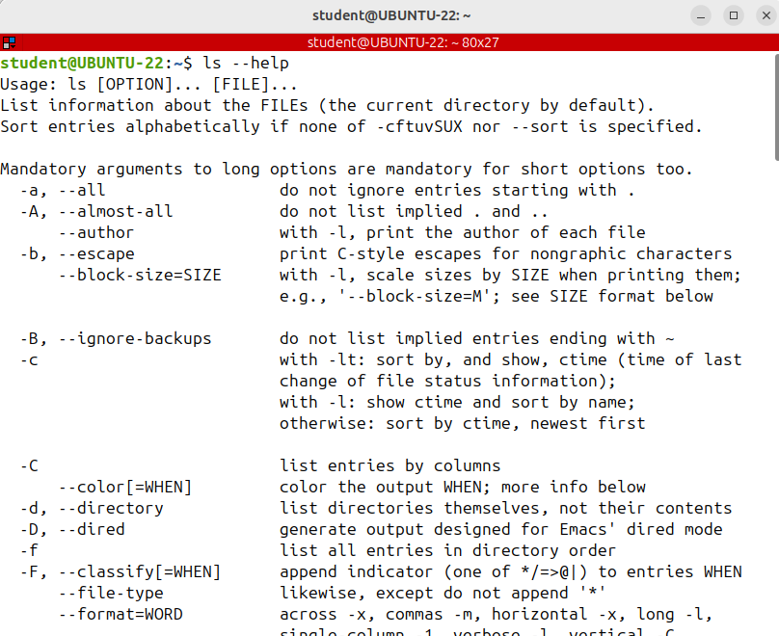
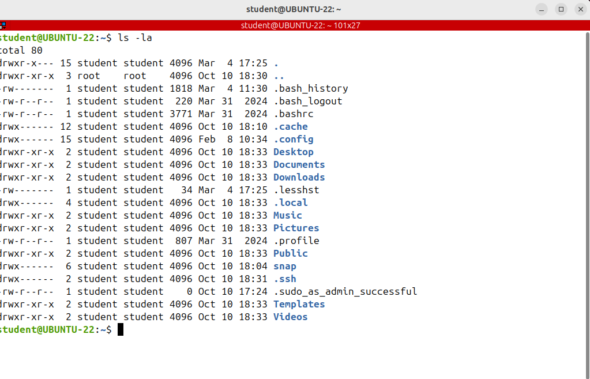
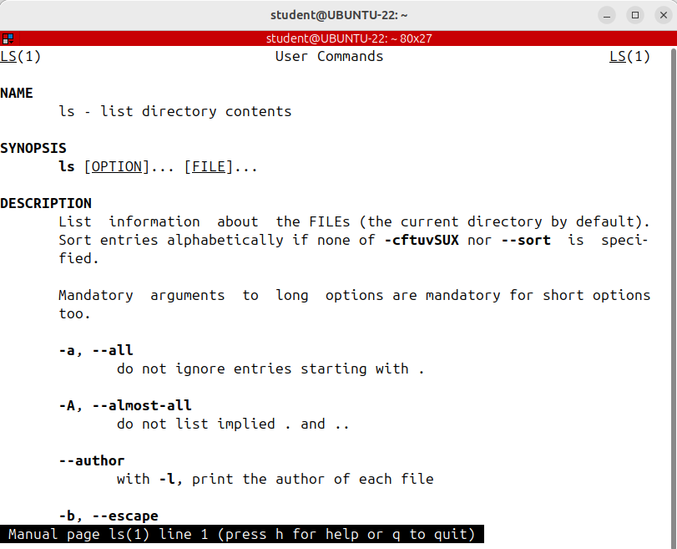








THE ls COMMAND IN DEPTH
GROUP OWNER
Let's dive deeper into the ls command which is probably the most used command in Linux. As I’m sure you already know, ls used to list the contents of a directory together with lots of other information about files and sub-directories.
Even though ls is a common command, it's a complex one, with plenty of options.
by default, the ls command will not show hidden files. In Linux a hidden file or directory is any file or director whose name begins with a dot. To display all files, including the hidden ones, use the -a option.
The first character indicates the file type: An hyphen (-) as the 1st character indicates a normal file,
‘d’ indicates a directory and “l” indicates a symbolic link which is sort of a shortcut.
MODIFICATION TIME
To sort by extension, use the -X option, written in uppercase.
Files are sorted by extension.
GROUP OWNER
Note that ls does not display the real size of a directory as you'd expect. It displays only the size of the node structure.
To see the size of a directory use the du (disk usage)command instead.
The nine characters that follow indicate the file permissions for the owner, the group owner and the
others.
OWNER

Slide 12

THE ls COMMAND IN DEPTH
To sort by extension, use the -X option, written in uppercase.
Files are sorted by extension.

Slide 13




THE ls COMMAND IN DEPTH
At the end, let me tell you something that will definitely surprise you. Up until now in the course, we've never actually run the original ls command.
If you run type ls, you'll see that there's an alias called ls to ls --color=auto
The --color=auto is the option that provides the different colors for the different file types in the listing. That’s why when you run ls -l
you see directories in blue,
regular files in black,
symlinks in cyan
device files in yellow on a black background.
And if you want to omit certain files from the listing, use the --hide option.
If you don't want to see the files which end in that conf in the listing, you can run this command:
ls --hide=*.conf /etc
With -R option you can list directories recursively.
Recursively means that ls works its way through the entire directory tree below the starting directory,and lists the files in each subdirectory.
If you want to run the original ls command without adding --color=auto, run \ls and you’ll see everything displayed in black. The \ char cancels the alias.

Slide 14



THE ls COMMAND IN DEPTH

Slide 15






Understanding File Timestamps: atime, mtime, ctime (stat, touch, date)
Linux timestamps hold an integer number rather than a date and time.
This number is the number of seconds since the unique epoch, which was midnight on January 1st, 1970
Modification time
Access time
Change time
Maximum precision

Slide 16






Understanding File Timestamps: atime, mtime, ctime (stat, touch, date)
If you want to change only the access time to the current time, use the -a option.
So touch -a linux.txt; and stat linux.txt
Note that the access time was updated to the current time, the time was also updated because metadata information of the file like atime was changed.
This is normal behavior.
You can also use the -r option if you want to set the timestamps of one file to the timestamp values of another one.
If you want to change simultaneously both access and modification time, use the -d like this touch -d between double quotes a date, in this format, and the file.
If you want to set the access time or modification time to a specific time, not the system current time, you can use -d option and a datetime.
Changing the file timestamp:
This is useful when you want a back up program to include or exclude some files or when you simply do not want other users to know that you've read or modified the file;
you can change the time stamp on a file using the touch command.
The touch command is also used to create an empty file.
To change the modification timestamp, you can use the same -m option :
touch -m –t date linux.txt
stat linux.txt;
See how both mtime and change time were modified.

Slide 17



Sorting Files by Timestamp
If you want to reverse the order of sorting add the -r or the -- reverse option
This is a common task.
By default, the ls -l command is showing the modification time, this is the modification time for each file, and sorting the output by name and the ls command is listing the files in alphabetical order.
If you want to sort by modification time at the -t option, it will display the output sorted by modification time, newest files first.
They are sorted by modification time. If to -t option, you add the -u option, then it will sort by access time.

Slide 18


FILE TYPES IN LINUX
In Linux, the file is a central key concept. When administering a Linux system, you have to deal with lots of files and knowing their type is really important.
We'll see what type of files are available.
Linux determines the type of a file via a code in the file header.
It doesn't depend on the file extension.
Linux for files to not have any extension at all.
These are only a few examples of important system files that do not have an extension:
Contain a public directory of user accounts, providing basic details but not sensitive information like passwords.
is a critical system file that securely stores encrypted user passwords and account-related information, such as password expiration dates. Due to its sensitive nature, only the root user can access it, ensuring password security
Manages file and directory access permissions for user groups
These executable files have no extension.
In Windows, they would be .exe files.
This is one of the differences between Linux and Windows. In Linux file extensions do not matter so much. They are mostly for humans to find out visually what the specific file could represent.
When you see a file name which ends in .log, then it's probably a log file or a file which ends in .conf it's probably a configuration file.
it contains general system log messages.

Slide 19


FILE TYPES IN LINUX

Slide 20




Quiz time

Slide 21




Quiz time

Slide 22






VIEWING FILES (cat)
it's also concatenating files into a single one.
The entire configuration of the Linux system is saved in text files. User accounts and their passwords groups, the network configuration, the security policy, the configuration of any network service like a Web, FTP or an email server are all saved in text files.
I'm going to show you different ways to read text files on a Linux system.

Slide 23


VIEWING FILES (less)
the most important and used options:
you can get additional help by typing the letter h.
To exit the file type q.
you can use the arrow keys to move a line up or down.
To forward one window press on CTRL+f or on the space key.
If you want to move backwards a screen or a window, you press CTRL+ B.
to go to the very beginning of the file typed lowercase g
to go to the very end type uppercase G.
If the output of a text file exceeds the terminal window you probably want to use the "more" or "less“ commands instead of cat.
Both tools are known as pagers and will take the input from a file and send it to the terminal one page at a time.
Less extend the capabilities of more and is probably the most advanced and used reading tool that Linux provides
Sometimes you want to search in the current file for a specific string. Let's say I want to search for the root string in this file.
First, I'm going to the beginning of the file by pressing g.
I'm at the beginning and to search for the string, I write a / and the string I want to search for root
Press enter.
press n for next match
Press N for previous match

Slide 24

VIEWING FILES (tail, head, watch)
Using tail you can view the last lines of a file and by default it shows the last 10 lines.
The command I've just executed has shown the last 10 created users.
Tail has several options that can be used to get the desired output.

Slide 25


VIEWING FILES (tail, head, watch)
It will display the last lines of the file, starting with the line number 20.(from line 20 to the end)
Tail is really useful for reading a file in real time, like when you want to view the last n lines of a log file for important system messages

Slide 26






VIEWING FILES (tail, head, watch)
You use tail to watch log files as they are updated.
Using the -f option, tail automatically prints new messages from an open file to the screen
in real time; for example, to actively watch as users log in and out

Slide 27


VIEWING FILES (tail, head, watch)
The last command I'm going to show you is head. It’s the complementary of tail command, and as the name implies, prints the top N number of lines from a given file.
Head is used to display the beginning of a file: head /etc/passwd
By default, it reads the first 10 lines of a file, so the previous command has printed out the first
10 users

Slide 28





VIEWING FILES (tail, head, watch)
I'll introduce you to another Linux command, which has nothing to do with viewing
files but could be very useful.
if you want to run a command repeatedly displaying its output and erroryou use the watch command.
It allows you to watch the program output change over time.
To interrupt it press CTRL+C
Two interesting options are -d to highlight the differences between successive updates and -n
and a number to specify the update interval. I'm running the ls-l command every 3
seconds, highlighting the differences

Slide 29





QUIZ TIME

